Slide 1
Mckinsey global Institute Job automation

Slide 2
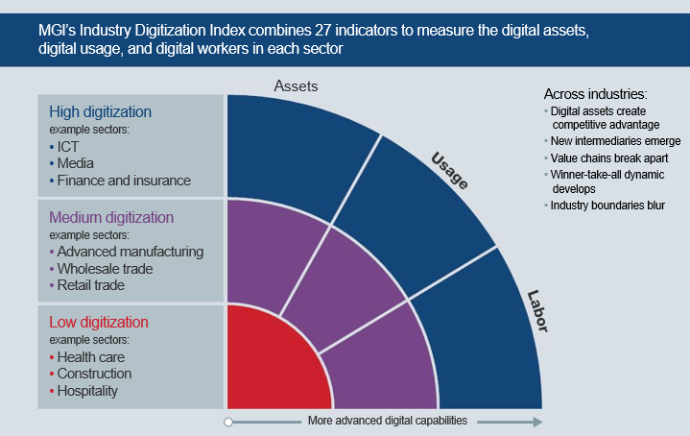
ICT; information and communication technology

Slide 3
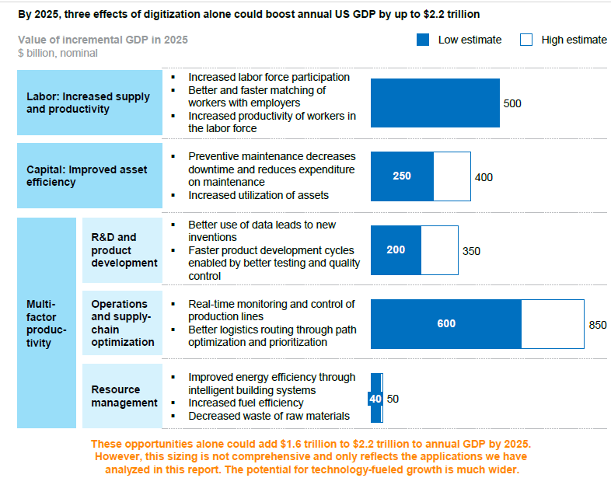


Slide 4
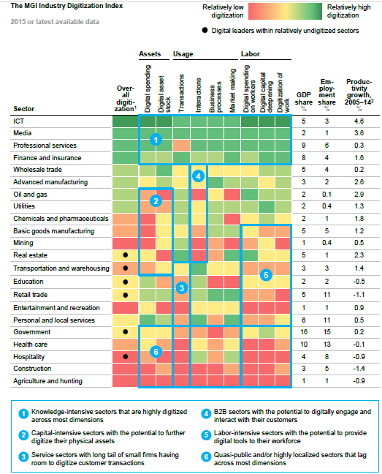
Copyright 2010 John Wiley & Sons, Inc.

